Slide 1


Slide 2
ABOUT US
All Executive is a certified woman-minority/ small business enterprise founded in 2018. We specialize in delivering meticulous post-construction cleaning services, ensuring every project meets the highest standards of cleanliness and safety.
Our mission is to: ✅ Continuously enhance our skills to stay ahead in the industry
✅ Elevate our services to exceed client expectations ✅ Prioritize customer satisfaction with every project
Renowned for our attention to detail and reliability, we guarantee exceptional cleaning solutions that provide peace of mind to our clients.
Experience the All Executive difference—where excellence meets reliability.

Slide 3
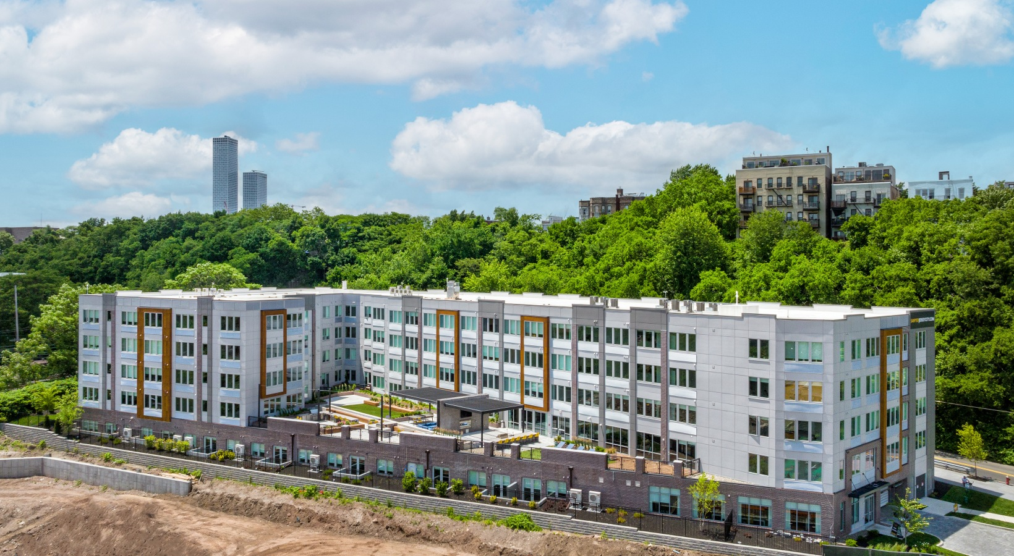
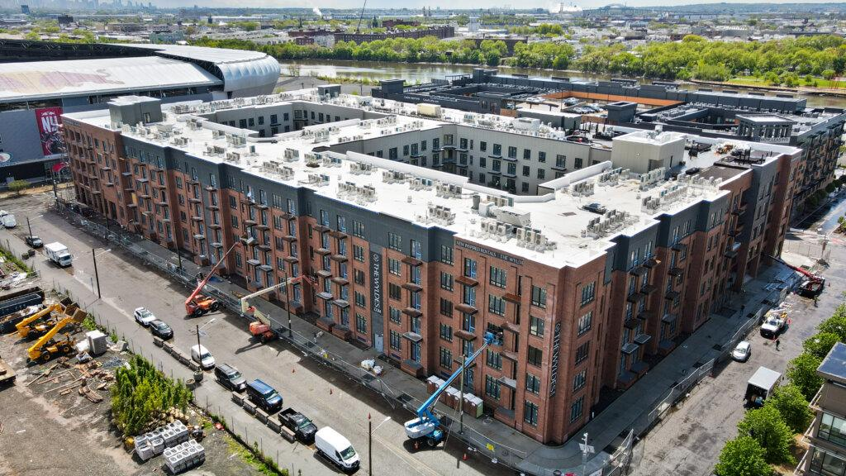
Sawyer
39 New York Ave, Jersey City, NJ 07307
The Wyldes
1100 S 5th Street, Harrison, NJ 07029
Completed a 3-phase cleaning for this 127-unit apartment complex with amenity spaces, delivering spotless results from start to finish!
Completed a 3-phase cleaning for this 399-unit mixed residential and commercial building, including pristine amenity spaces!

Slide 4
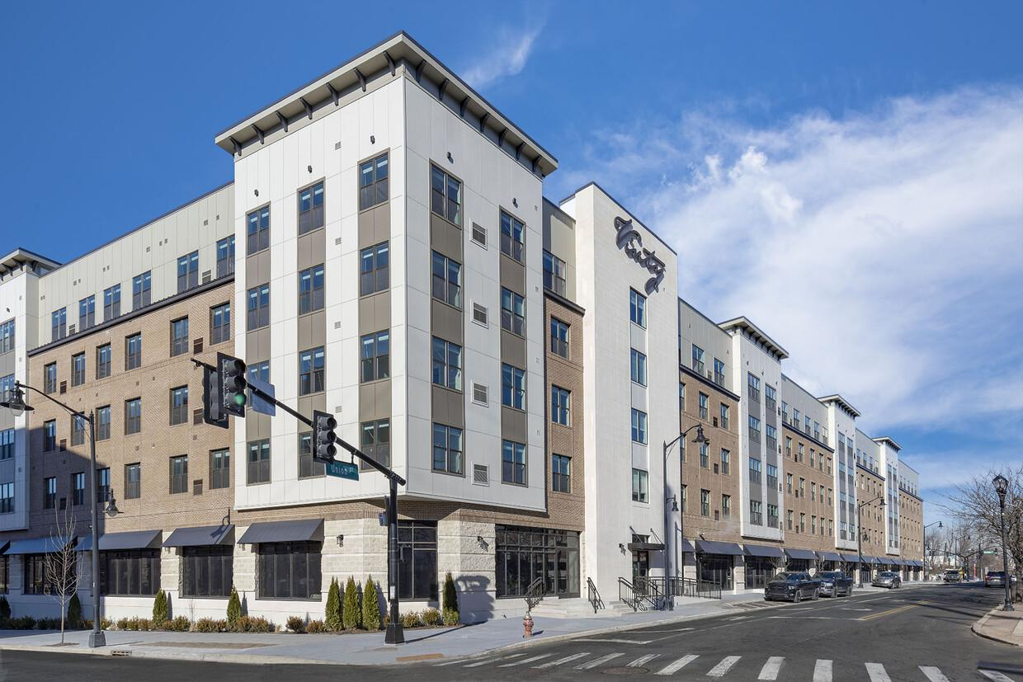
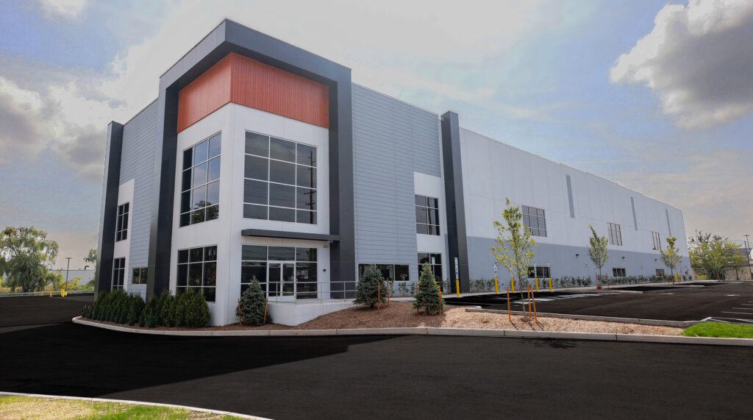
Vinty
190 Union Street Elizabeth, New Jersey 07202
Daylight Transport
611 Tonnele Ave, Jersey City, 07207
Delivered a 3-phase cleaning for this 267-unit apartment complex, including its beautiful amenity spaces!
Completed a final clean for this massive 100,000 sq. ft. distribution facility, ensuring it's spotless and ready for operation!

Slide 5
SERVICES:
Construction Cleaning: Clearing debris, dust, and materials from construction sites to maintain a clean, safe working environment.
Demolition Cleaning: Efficient removal of rubble, waste, and hazardous materials post-demolition, preparing the site for the next phase.
Rough & Final Cleaning: Detailed cleaning after major construction phases (rough) and final polishing to prepare spaces for use or occupancy.
Punch List Cleaning: Cleaning to address specific tasks, ensuring the site meets completion standards and is move-in ready.

Slide 6
CONTACT US:
WEBSITE: WWW.ALLEXECUTIVECLEAN.COM
EMAIL: ALLEXECUTIVECLEAN@GMAIL.COM
PHONE: 908-361-0234

